Slide 1
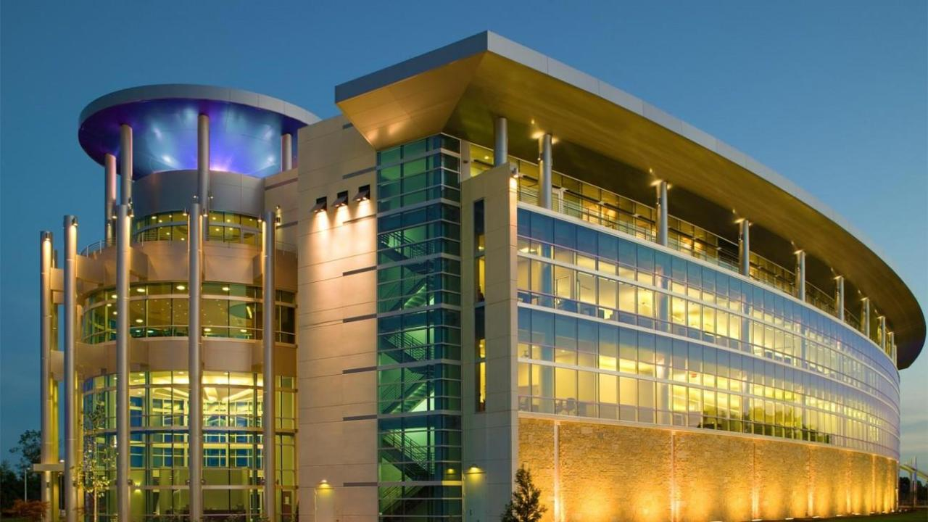


Trends in Lighting Technology

Slide 2
Introduction
David Venhaus
Sr. Solutions Specialist
Hubbell Lighting, Inc.
701 Millennium Blvd.
Greenville, SC 29607
direct: 864-678-1140
e: dvenhaus@hubbell.com
w: www.lightingsolutionscenter.com

Slide 3
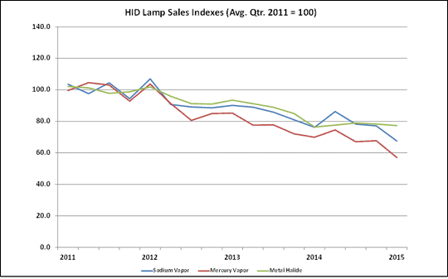
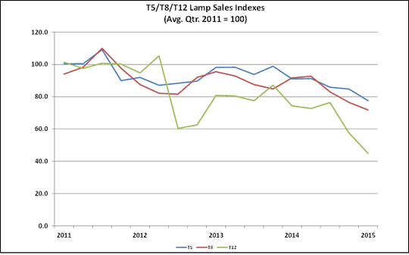
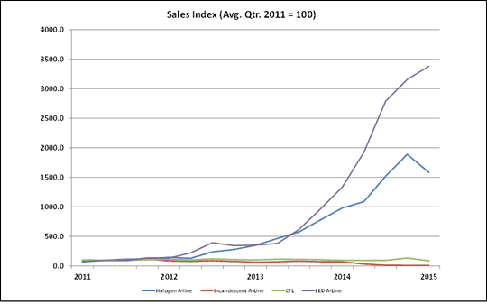
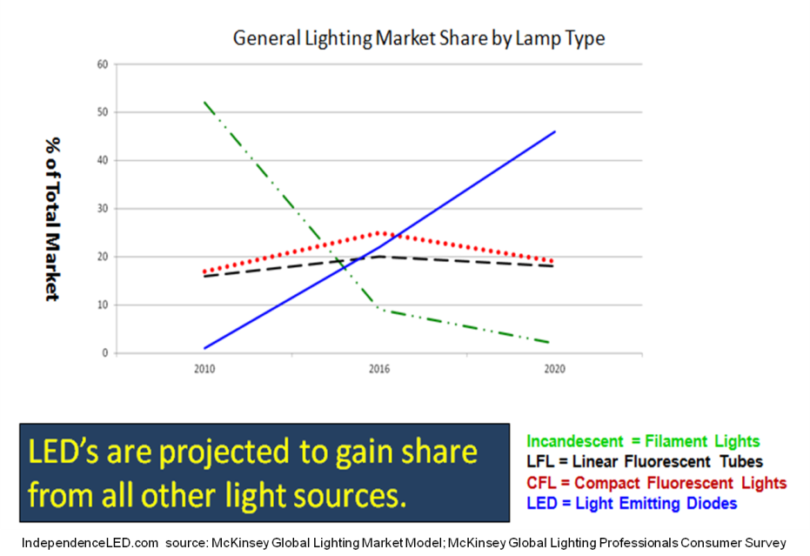
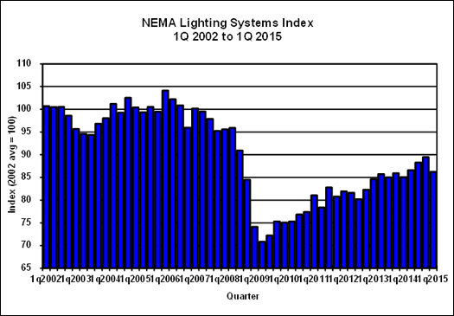
NEMA - Market Trends
HID
Fluorescent
Consumer

Slide 4
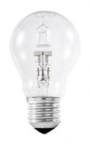

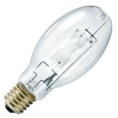
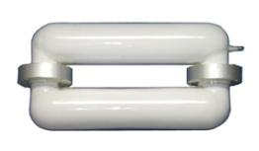
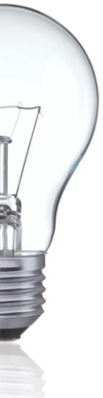



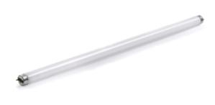


Evolution of Artificial Light
1879
Thomas Edison patents a carbon filament vacuum incandescent lamp
1930s
Mercury Vapor, Low Pressure Sodium, and the first Fluorescent are created
1970s
Color Improved HPS & MH. High CRI Fluorescent, and Electronic Ballasts
1990s
High CRI HPS, Ceramic MH, Induction, T5 & T12 Fluorescent, HO Blue LED
1920
The first gas discharge source, “Neon”, is invented
1960s
High Pressure Sodium, Metal Halide & color corrected MV lamps introduced
1980s
CFL, T10, & T8 Fluorescent Lamps. LED and EL signs introduced
2000s
Large scale acceptance of CFL; proliferation of LEDs for general lighting
There’s a common thread here… Anyone ?

Slide 5
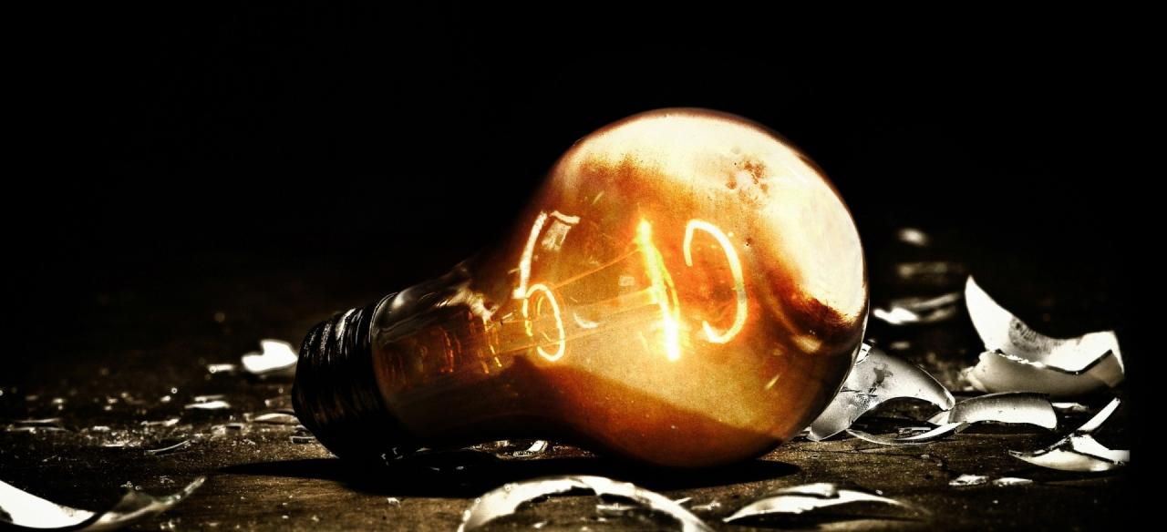
The Shift to Solid-state
LED is the first commercially viable light source not based on a vacuum tube !
This is a true paradigm shift !

Slide 6
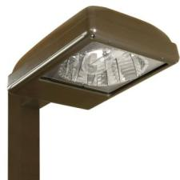
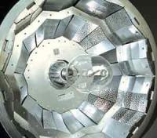
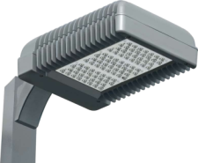
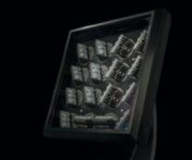
Fixture Manufactures Role are Changing
Legacy Technologies – Select and Source
Source
Ballast
Socket
Manufacture
Fixture Assembly
Lamp
Optic
SSL Technology – Create and Innovate
Source
Fixture Assembly
LED
Chip
Circuit Board
Power Supply
Thermal Mgmt
Light Engine Assembly
Manufacture

Slide 7
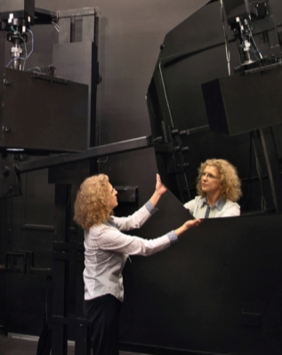


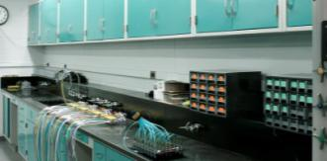

Critical Skill-sets
Critical Engineering Skillsets:
  Thermal / Mechanical
  Electronics & Power Supply Engineering
  LED Optical Design
  Embedded Software & Control
  Electronics Reliability Testing
Critical Operations / Manufacturing Skillsets
  Surface Mount Technology Manufacturing
  ESD Control
  Conformal Coating
  Electronics Supply Chain Management

Slide 8

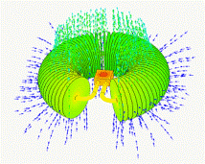

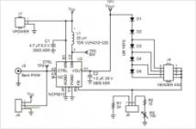
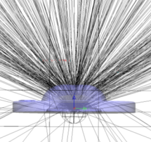

Tools and Expertise
Thermal / Mechanical
  Computational Fluid Dynamics (CFD)
  Heat sink & Interface Materials
Electronics & Power Supply Engineering
  SMT circuit board design & development
  Adaptive electronics & controls
  Power supply development
  Direct drive AC
  Surge suppression
LED Optics
  Advanced ray tracing and simulation

Slide 9
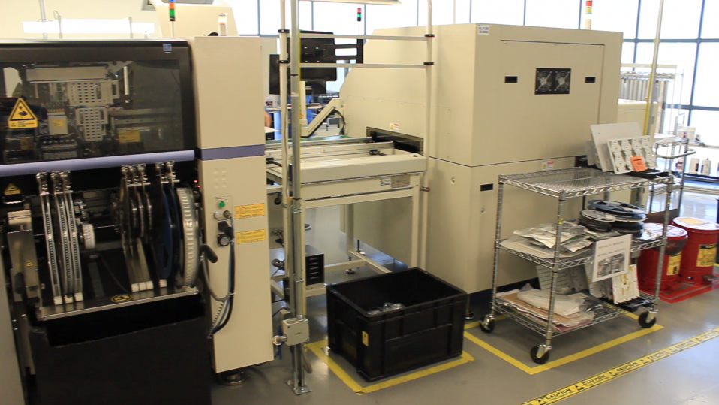
New Equipment Required
Modern chip shooters can place 30,000+ emitters per hour !

Slide 10

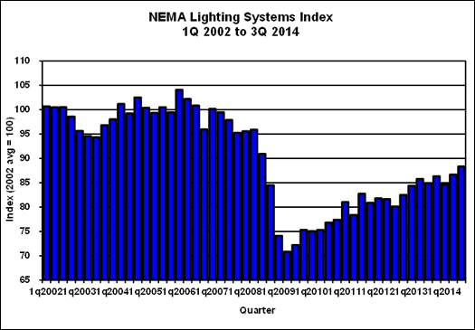
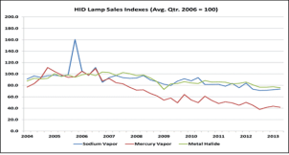
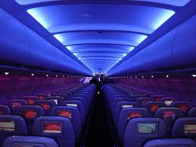
The Market has Changed
Emerging from 2008 downturn with new technology
Energy Supply vs. Demand
Emergence of a national energy policy (ASHRAE 90.1-2013)
Green Building & Shifting to Retrofit
Advancement of Daylighting in common interior applications
Emergence of demand response and distributed automation
Emergence of new light sources (ex: LED, OLED & Plasma)
Limitless flexibility (source, shape and otherwise)
New opportunities in light & human health

Slide 11

New Technology… New Standards
What method should be used to measure LED flux and color maintenance? (LM-80-08)
What method should be used to project LED lifetime? (TM-21-11)
What method should be used to measure LED luminaire flux and color maintenance ? (LM-84-14)
What method should be used to measure LED luminaire photometry? (LM-79-08)
What is the impact of spectrum on mesopic vision? (TM-12-12)
What is the impact of spectrum on photopic vision? (TM-24-13)
What is the impact of spectrum on the environment and human health? (RP-33-14)
Does CRI accurately characterize LED color quality? (TM-30-15)
Is there a difference between the apparent color of LED sources?
How do we project luminaire color quality/consistency?
Can we standardize and ensure light engine, driver, luminaire and control compatibility?
How do I specify LED performance (vs. prescriptive approach)?

Slide 12
Evolution of LED Technology
8/25/2015

Slide 13
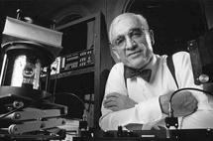
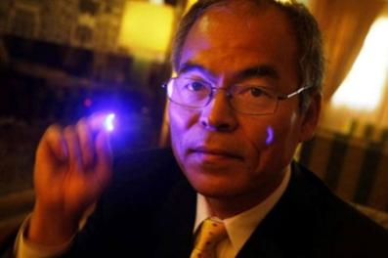


We didn’t get here in a hurry…
Dr. Nick Holonyak (1962)
Dr. Shuji Nakamura (1993)

Slide 14








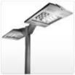
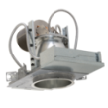
The Use and Application of LEDs
Specialty Lighting (Traffic Signals, Toys, Industrial Displays)
  Monochromatic
Display Lighting (Indoor / Outdoor Backlit Commercial Displays)
  Phosphor converted, high color temperature (CCT)
LCD Backlighting (Cellular Phone, Laptops, Monitors, etc.)
  Phosphor converted, broad color temperature range (CCT)
Automotive (Interior & Exterior)
  Increased flux (lumen output), Improved thermal stability
General Lighting
  High powered, increased color quality (CRI), increased efficiency

Slide 15
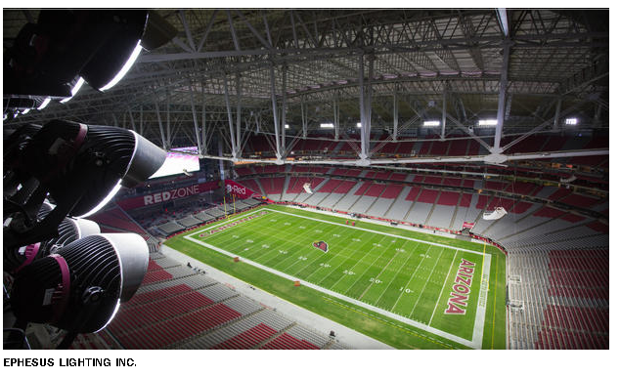
Super Bowl XLIX

Slide 16


Evolution of Technology
Months…
Decades
Feasibility
Practical & Justified
“IT SHOULD BE DONE”

Slide 17

Checking the Box
High Efficacy: 110+ lm/W
Excellent Color Quality: Up to 98+ CRI
Optical Performance: >93% Optical Efficiency
Dimmable – Commonly a standard option
Long Life – L70 of 50,000hrs to 100,000 + + hrs
Practical: Pricing quickly stabilizing

Slide 18
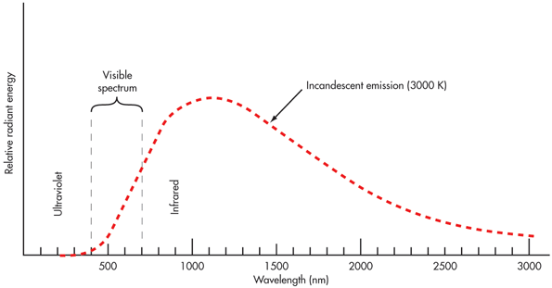
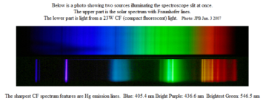
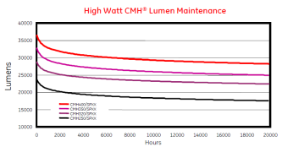
LED Value Proposition
18

Slide 19
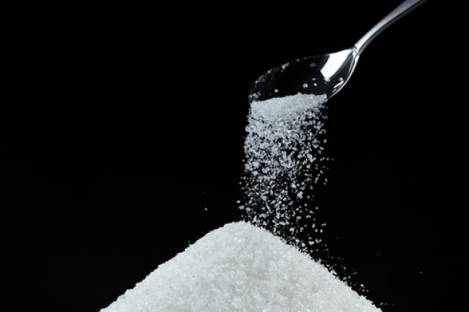
LED Value Proposition
Long Life – Low maintenance
Efficient – Low energy use
Robustness – High reliability
Small source size -- allows for superior optical control
Full Spectrum – Enhanced color
Cool Beam – No projected heat
No IR or UV – Wide application
Mercury Free – Good for environ.
Low Voltage – Ease of Use
Heat Reduction - (3.41BTU / W)
Favorable ROI – Great investment

Slide 20
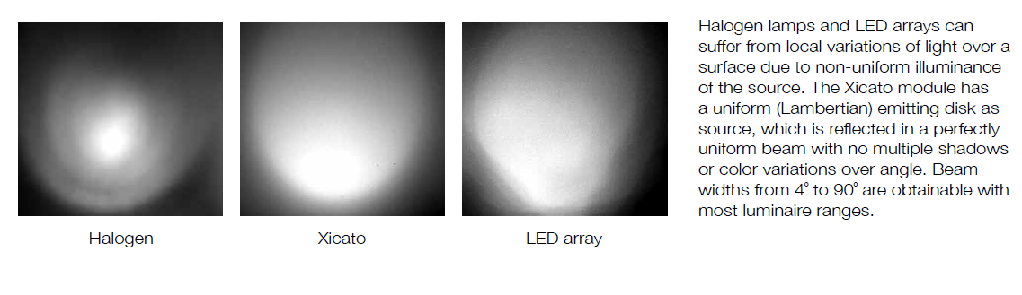
LED is solving problems that always existed…

Slide 21
Economics & Adoption of LED Technology
8/25/2015

Slide 22
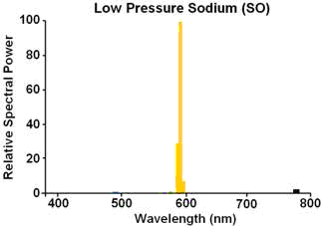
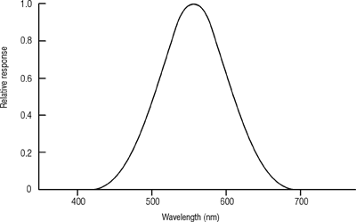
Market Update
LPS is not considered…
Beware, there is a wide range in LED source performance
There are “lagging” and “leading” suppliers
LED is now the highest efficacy “white light” source on the market

Slide 23
Market Update
There is typically a 5yr lag between LED R&D and production levels
Based on converting blue to white (phosphor)
At the top end, lower CCTs will have greater efficacy than cooler colors (ex: 5000K)
Higher CRI will typically lower efficacy
350lm/W Theoretical Ceiling 20XX
315lm/W 2015 Laboratory
>217lm/W 2017 Production
197lm/W 2015 Production
May 2013 LED Benchmark: 167lm/W (Production), 254lm/W Lab
http://www.photonics.com/Article.aspx?AID=28677
Notes:
While we think that we would naturally increase lighting efficiency

Slide 24

Price vs. Performance
+5-10%
YoY
-25-30%
MP LED’s: ~10% greater lm/W, ~10% lower cost

Slide 25
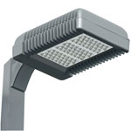
The Balance has Shifted
COGS 90-LED Outdoor Area Luminaire (2008)
COGS 90-LED Outdoor Area Luminaire (2015)
Notes:
http://en.wikipedia.org/wiki/File:Haitz_law.svg

Slide 26

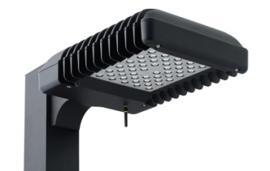

Emitters are no longer the major cost driver
CL1
CL1S
=
$
Weight - 45.0 pounds, EPA - 1.3 ft²
6.75” (H) x 21.75” (L ) x 16” (W)
Mechanical COGS %
2013
20XX
The Luminaire housing has become new target of opportunity
Weight - 19.0 pounds, EPA - 0.45 ft²
4.13” (H) x 16.31” (L ) x 12” (W)
2008
2015
Thermal mass & surface area requirements reduced in proportion to LED performance increases
Notes:
http://en.wikipedia.org/wiki/File:Haitz_law.svg

Slide 27
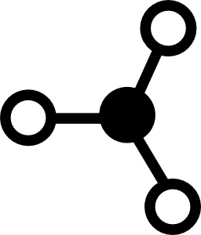
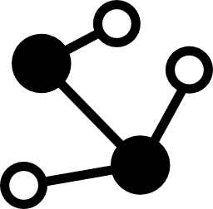
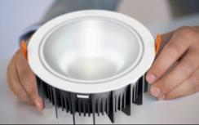
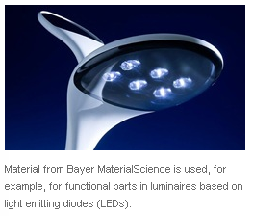
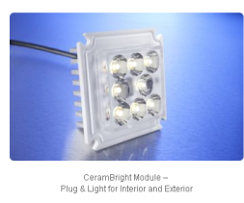
Alternative Luminaire Materials
Thermally-Conductive Polymers 22W/m·K
Graphite Foam 135W/m·K
High Density Aluminum Die cast 161W/m·K
Sintered Powdered Metal 160W/m·K
Ceramic 170W/m·K
Die cast Aluminum 109W/m·K
Osram LED downlights keep cool with thermally conductive Stanyl TC polyamide 46 from DSM (source: DSM Engineering Plastics: DSMPR435)

Slide 28
LED Package Trends
8/25/2015

Slide 29
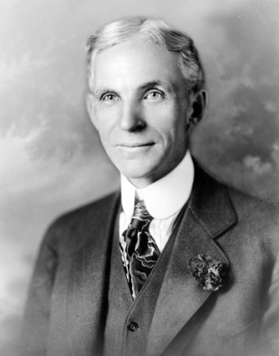
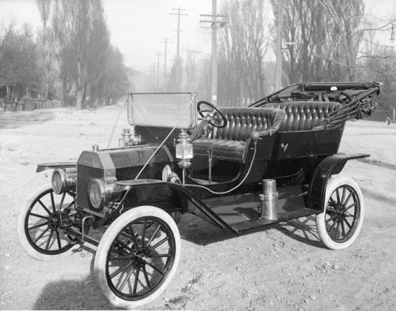
LED Package Trends
“Any customer can have a car painted any color that he wants… so long as it is black”
Remark about the Model T in 1909, published in his autobiography My Life and Work (1922) Chapter IV, p. 71; this has often been paraphrased, e.g.: "You can have any color as long as it's black."

Slide 30
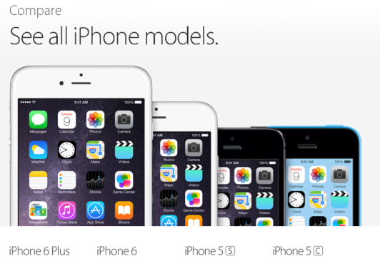
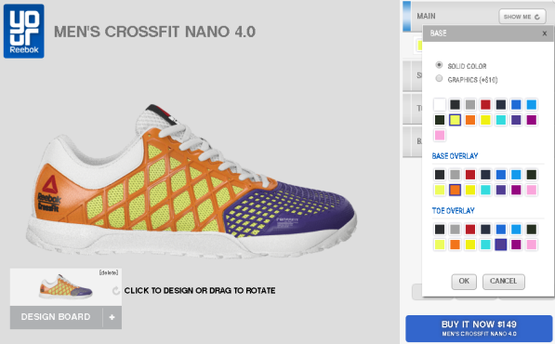
LED Package Trends
If there is anything that we have learned…
…one size does not fit all

Slide 31



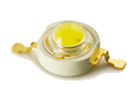

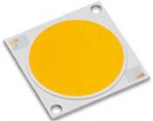







Variety & Stratification
Application-optimized
Smaller size; larger size too!
Multiple high power chips
Multiple small chips
Phosphor coatings vs. glob or dispersed
Higher wattage packages
Deposited silicone primary lens systems
Chip on Board (COB), a.k.a. “Fried Eggs”
Chip Scale Packaging (CSP)
High Voltage LEDs
Last Gen Packages
New Generation LED Packages
p.31

Slide 32










Component Specialization
Low & Mid-Power (<1W, 2.8-3.4VDC, 10-200mA, 0.23-0.56mm)
Ideal for interior luminaires, specifically recessed downlights & linear
Example: Nichia 757, Samsung 5630
Delivered lm
10’s
Multi-die (1-3W, 2.8-12VDC, 350-1000mA, 2-6mm)
Ideal for LED lamps and task lighting (replacement lamp & landscape)
Example: Nichia 183 Series
10-100’s
High-Power (1-3W, 2.8-3.4VDC, 350-1500mA, 1-3mm)
  Ideal for outdoor products (parking lot, roadway, flood lights, etc.)
  Example: Nichia 219B, Cree XP-G2, Osram Oslon
low 100’s
Multi-die High-Power Array (>9W, 24VDc+, 700-3000mA, 12+mm)
Ideal for reflector lamp replacements (PAR lamps, MR lamps, etc.)
Example: Cree MP-L, MK-R
100’s
COB / Array (~15-200W, 24VDC+, 700-5600mA, 12-50mm)
Ideal for high lumen applications (Highbay, Downlights, Floodlighting)
Example: Nichia NSC Series
1000’s
High Flux Density Discrete (HFD) LED (~3-32W, 37V, 1000mA, 7mm)
Ideal for high lumen applications (Highbay, Downlights, Floodlighting)
Example: Cree MHD-G, XHP70
100-1000’s

Slide 33


Evolution of a 1000lm LED Downlight
Complexity & Cost
Performance
12
Gen-1
High Power
36
Mid-power
6
Gen-2
High-power
1
2008 – 2015
$100 to $25
50lm/W to 120lm/W
70CRI to 90CRI
COB
1
HFD
Fewer components, smaller LES, greater scalability, reduced complexity

Slide 34




The question…
HID
“What is your equivalent to _________”
The old metrics:
  Wattage
  Lumens
  lm/W
LED
Lamp Lumens: 36,000lm
Luminaire Lumens: 27,000lm
Lamp Wattage: 400W
Luminaire Wattage: 465W
Luminaire Efficiency: 45 - 75%
Luminaire Efficacy: 58 lm/W
Color Temperature: 5000°K
Color Quality: 65CRI
IES Distribution: Type III Short
Lamp Lifetime: 20,000 hours
Luminaire Lifetime: 20 years
Lamp Lumens: n/a
Luminaire Lumens: 15,200lm
Lamp Wattage: n/a
Luminaire Wattage: 135W
Luminaire Efficiency: 60 – 85%
Luminaire Efficacy: 115 lm/W
Color Temperature: 4000°K
Color Quality: 70CRI
IES Distribution: Type III Medium
Lamp Lifetime (L70): 60,000 + hours
Luminaire Lifetime: 13.7 years (?)

Slide 35


IES ROAD REPORT
PHOTOMETRIC FILENAME : WPC15MH175.IES
DESCRIPTIVE INFORMATION (From Photometric File)
IESNA:LM-63-2002
[TEST] 08646
[TESTLAB] LUMINAIRE TESTING LABORATORY, INC.
[ISSUEDATE] 01-25-2005
[MANUFAC] QSSI
[LUMCAT] WPC15MH175
[LUMINAIRE] CAST ALUMINUM HOUSING, FORMED SEMI-SPECULAR ALUMINUM
[MORE] REFLECTOR, CLEAR GLASS ENCLOSURE.
[LAMP] ONE CLEAR HORIZONTAL M57 175 WATT ED17 METAL HALIDE LAMP RATED
[MORE] AT 12,000 LUMENS.
[LAMPCAT] SYLVANIA M175/U/MED
CHARACTERISTICS
IES Classification Type II
Longitudinal Classification Very Short
Cutoff Classification (deprecated) Full Cutoff
Lumens Per Lamp 12000 (1 lamp)
Total Lamp Lumens 12000
Luminaire Lumens 5041
Total Luminaire Efficiency 42 %
Downward Total Efficiency 42 %
Upward Waste Light Ratio 0.00
Maximum Candela 3089.99
Maximum Candela Angle 175H 25V
Maximum Candela At 90 Degrees Vertical 0 (0.0% Lamp Lumens)
Maximum Candela from 80 to <90 Degrees Vertical 120.857 (1.0% Lamp Lumens)
Total Luminaire Watts 175
Ballast Factor 1.00
Photometric
FLUX DISTRIBUTION
Lumens Percent Of Lamp
Downward Street Side 2474.1 20.6
Downward House Side 2567.3 21.4
Downward Total 5041.4 42.0
Upward Street Side 0.0 0.0
Upward House Side 0.0 0.0
Upward Total 0.0 0.0
Total Flux 5041.4 42.0
You would LITERALLY be better off mounting this fixture BACKWARDS on the wall !

Slide 36













It’s Not All About Raw Lumens… Better Optics Make a Difference !
Wall Pack
20,333 lumens
164,384 CBCP
220W
16.4fc @ 100’
Narrow Flood
18,031 lumens
259,948 CBCP
220W
25.9fc @ 100’
280W – T5W
27,000 lumens
422W – T5W
35,000 lumens
8 CBCd / lm
14CBCd / lm
30’ Mounting Height – 50’ Grid, 142W less Power
Smaller source generally leads to greater max beam candela per lumen
Prescriptive vs. Performance Specifications

Slide 37
CCT & Performance
Cold Lumens / LED @ 700mA (350mA / mm²) @ 25°C
CRI | 6500K | 5700K | 5000K | 4500K | 4000K | 3500K | 3000K | 2700K | 2500K* | 2200K*
~67 |  |  | 305
>70 | 271 | 284 | 297 | 295 | 294 | 286 | 276 | 262
>80 |  |  | 273 | 268 | 264 | 261 | 250 | 236 | 225 | 200
>90 |  |  |  |  | 210 | 202 | 190 | 176
% Flux vs. CCT (Baseline: 5000K LED, 67CRI)
~67 |  |  | 100%
>70 | 88.85% | 93.11% | 97.38% | 96.72% | 96.39% | 93.77% | 90.49% | 85.90%
>80 |  |  | 89.51% | 87.87% | 86.56% | 85.57% | 81.97% | 77.38% | 73.77% | 66.57%
>90 |  |  |  |  | 68.85% | 66.23% | 62.30% | 57.70%
lm/W vs. CCT
~67 |  |  | 152.50
>70 | 135.50 | 142.00 | 148.50 | 147.50 | 147.00 | 143.00 | 138.00 | 131.00
>80 |  |  | 136.50 | 134.00 | 132.00 | 130.50 | 125.00 | 118.00 | 112.50 | 100.00
>90 |  |  |  |  | 105.00 | 101.00 | 95.00 | 88.00
Performance GAP between low and high CCTs is narrowing

Slide 38




Dim-to-Warm Technology
Traditional Incandescent Lamp
Standard Dimmable LED Lamp
Dim-to-Warm LED Lamp
Dim-to-Warm LED Lamp

Slide 39


Dim to Warm Technology
Traditional Incandescent Lamp
Dim-to-Warm LED Lamp

Slide 40



Dim to Warm Technology
Multi-Channel Array
Accurate blackbody dimming
Maintains high CRI
Compact size & greater flux density
In-source color mixing
Manage CCT and illuminance independently
Highly sophisticated topology
Higher cost and power draw
Dual CCT Array - 2 CCT’s
Off black body “A-to-B” dimming curve
Maintains high CRI
larger size & lower flux density
extra-source color mixing
Manage CCT and illuminance independently
Lower sophistication
lower cost and lower power
Dual CCT Array – BSG w/Red
Off blackbody “A-to-B” dimming curve
Lowers CRI at dimming level
larger size & lower flux density
extra-source color mixing
Lower sophistication
lower cost and lower power
Provides lowest “perceived color”

Slide 41




Color is Key
What you see is what you get

Slide 42




Spectral Power Distribution – SPD
Sunlight
Halogen
3000K Fluorescent
3000K LED

Slide 43






Spectrum Matters

Slide 44





CRI vs. SPD
3000K, 86CRI Fluorescent
3000K, 85CRI LED

Slide 45
The Language of Light
OMG!
CRI
SPD
GAI?
CCT

Slide 46




Gamut Area Index Comparison

Slide 47


AC LED – BATTLE OF THE DECADE?

Slide 48




AC LED – What is it?
Driver-less LED Technology
Now
Then

Slide 49
AC LED – What’s all the hype?
Allows for elimination of traditional AC-DC driver
Drastically reduces system cost
Simplifies product development
Reduced component count, complexity & cost
Enables new form factors – driver fits on emitter board, not in a separate enclosure.
Easily integrates into legacy products (residential & commercial)
Little to no inrush current
Increased reliability
DLC compliant PF & THDI
Little to no radiated EMI
Simple surge and transient suppression circuit
Dimming*
Where did the driver go ?
?

Slide 50



AC LED – What’s the catch?
LED On-time
Greater sensitivity to input voltage
Voltage-specific designs (42 LEDs – 120V, 100LEDs – 277V)
Class 1 vs. Class 2
Dimming (Flicker more apparent as LED on-time decreases)
Flicker!
120Hz
120Hz with Capacitor
“Valley Fill”

Slide 51

AC LED – What’s the catch?
Source: IESNA Handbook

Slide 52





AC LED – Flicker vs. Application
High
Pressure
Sodium
Metal
Halide
Linear
Fluorescent
Incandescent
http://www.lrc.rpi.edu/programs/solidstate/assist/recommends/flicker.asp

Slide 53





AC LED – Other sources flicker too !
Source | Percent Flicker (%) | Flicker Index
Incandescent | 13.4 | 0.04
CFL Magnetic Ballast | 37.0 | 0.11
CFL Electronic Ballast | 5.1 | 0.01
Ceramic Metal Halide PAR38 | 6.5 | 0.02
50 W Halogen Spot | 6.7 | 0.02
High Pressure Sodium | 52.0 | 0.16
Metal Halide Lamp | 95.0 | 0.30
LED | 1-100 | 0-0.5
Link1
Link2
Link3
Reference Links:
http://apps1.eere.energy.gov/buildings/publications/pdfs/ssl/miller_poplawski_flicker_lightfair2014.pdf
http://www.cree.com/~/media/Files/Cree/LED%20Components%20and%20Modules/XLamp/White%20Papers/Flicker.pdf
http://apps1.eere.energy.gov/buildings/publications/pdfs/ssl/flicker_fact-sheet.pdf

Slide 54



LED On-Time for CCR
Since input is AC, LED’s only emit light when input voltage is greater than the LED series string forward voltage plus linear current regulators overhead.
CCR Example
Wasted power, calculate high-line:
$$PD ≅ICCR ×\left(VPK −VFLED\right)×0.707$$
-or-
$$PD ≅ICCR ×VPK\int_{t1}^{t2}{\sin{2πft(dt)}}$$
$$LED On−time≅[180−2×\sin^{−1}{(\frac{VLEDVF}{VPK})]/180}$$
For this 44 LED example, the on-time is only 43.3%!

Slide 55

LED On-Time for Tapped Linear
The 4-tap linear AC example below has an LED on-time of 80%!

Slide 56
AC LED – how does it work
Common High Voltage AC Topologies
  Bridge + High Voltage CCR
    Limited dimming range (low current draw for dimmer)
  Bridge + Tapped Linear ASIC
  Bridge + CCR/ASIC + Capacitor
  Bridge + CCR/ASIC + Capacitor + Microcontroller
  Bridge + CCR/ASIC + Capacitor + Micro + Radio
  Bottom line, maximize “on” time to reduce flicker factor and %

Slide 57












Future Trends
“The Internet of Things”

Slide 58






Future Trends
Sensor technology (Decorative & Non-Decorative)
Wired and Wireless technology protocols
  Zigbee
  Z-wave
  Synapse
  DALI
  0-10V
  DMX
Dash boarding & Analytics
Cloud connectivity- the IoT
Automated Diagnostics
Ease of Commissioning
Interoperability with other systems
Sequential control
Programmable Power Supplies (Configurable Output)

Slide 59
Accelerating Technology
Feasible
Practical
Ubiquity
“IT CAN BE DONE”
“IT SHOULD BE DONE”
WHAT ELSE CAN IT DO?
Weeks - Months

Slide 60




The future is now….
What do *you* want to see?

Slide 61
Questions?

Slide 62
Thank you.

